Slide 1
Unit testing in Java
Using JUnit and Mockito

Slide 2
What is unit testing?
Unit testing is a software development process in which the smallest testable parts of an application, called units, are individually and independently scrutinized for proper operation.

Slide 3
Why write the tests?
Speeds up the development
Improved code quality
Make sure you don’t break somebody else’s code
Improved collaboration experience

Slide 4
Unit testing - good practises
Put your unit tests in the packages with the same name as the tested class
Call your test class the same as the class you’re testing plus suffix „Test” (so if your class is called UserService, then the test should be called UserServiceTest)
The name of your test method should start with the word „test” followed by the name of the method that it tests (so if your method is called getUser, your test method should be called testGetUser)

Slide 5
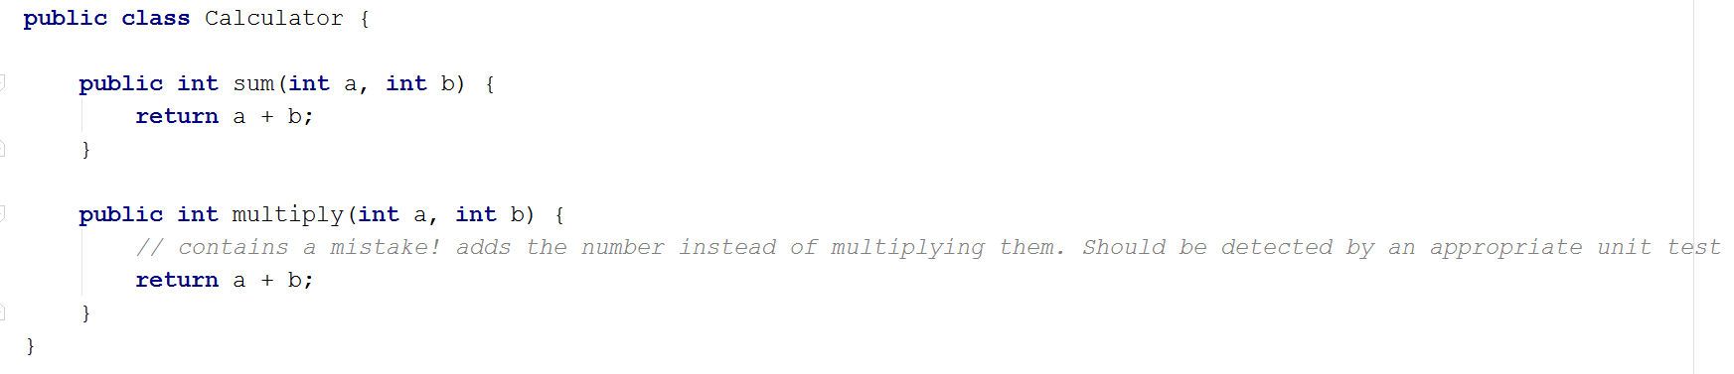
JUnit

Slide 6
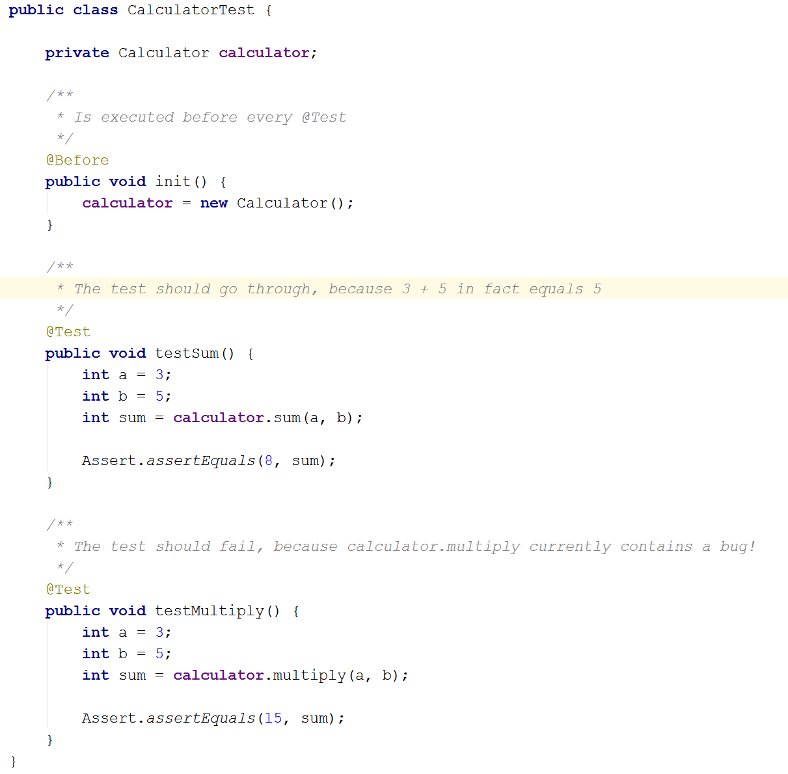
JUnit

Slide 7
JUnit – useful annotations
Annotation | Usage on method | Effect
@Test | Public void | Represents a test method
@Before | Public void | Executed before each @Test method
@After | Public void | Executed after each @Test method
@BeforeClass | Public static void | Executed once, before any tests are executed
@AfterClass | Public static void | Executed once, after all tests are executed

Slide 8
Dependency injection
Commonly used in Web applications
Provides a form of abstraction layer, making it easy to test each unit of the application separately from the rest
NOTE:
Many frameworks provide different annotations for performing dependency injection feature. For instance, sometimes it might be @Autowired and sometimes @Inject. Before you start using a new web framework, make sure how to properly perform dependency injection with it.

Slide 9
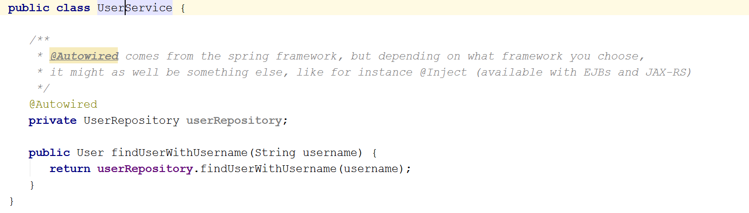
Dependency injection

Slide 10
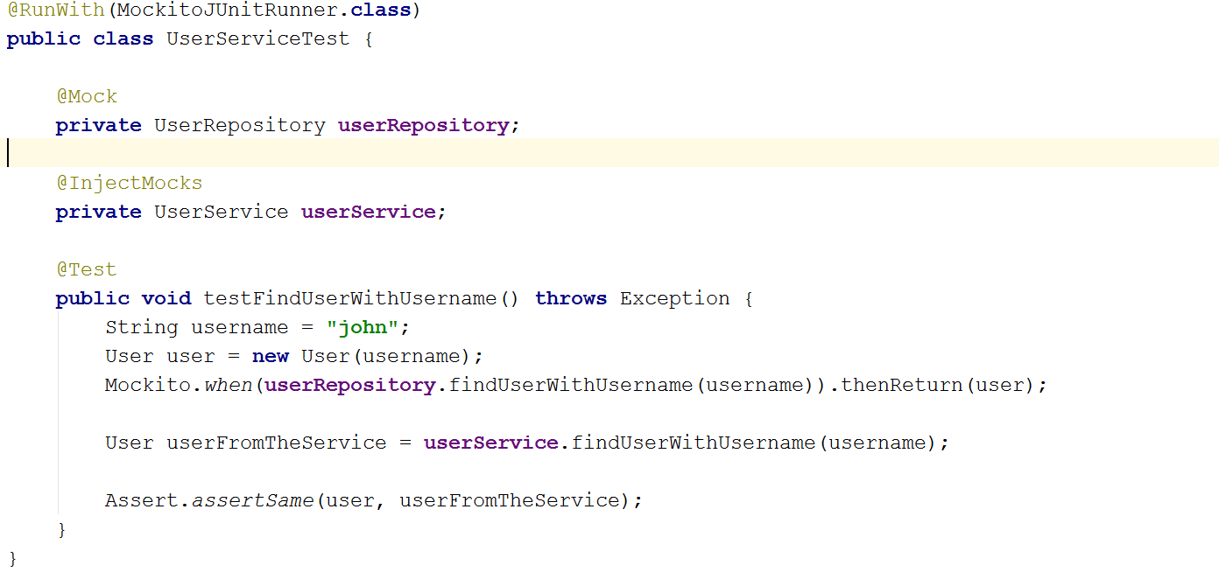
Dependency injection - Mockito

